Slide 1
Class Introduction
BUS 696: Machine Learning for Managers
Prof. Jonathan Hersh

Slide 2
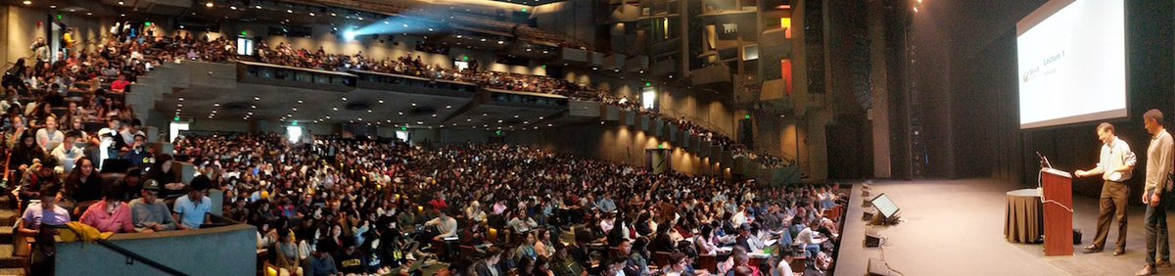
Intro to Data Science Class @ Berkeley
Welcome to BUS 696!
Be glad you’re not in this class

Slide 3
BUS 696
Syllabus
Intro to Class Materials
Ice Breaker
Intro to R / RStudio

Slide 4
BUS 696
Syllabus
Intro to Class Materials
Ice Breaker
Intro to R / RStudio

Slide 5
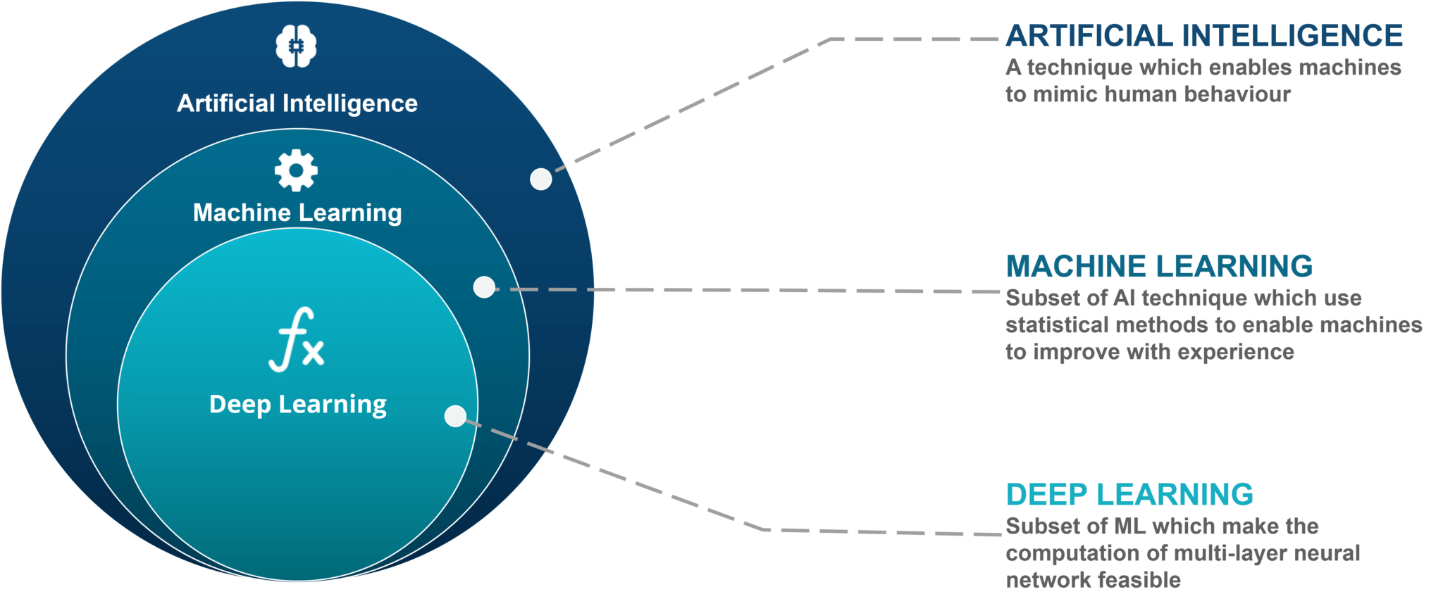
What is Machine Learning? What is Artificial Intelligence?

Slide 6
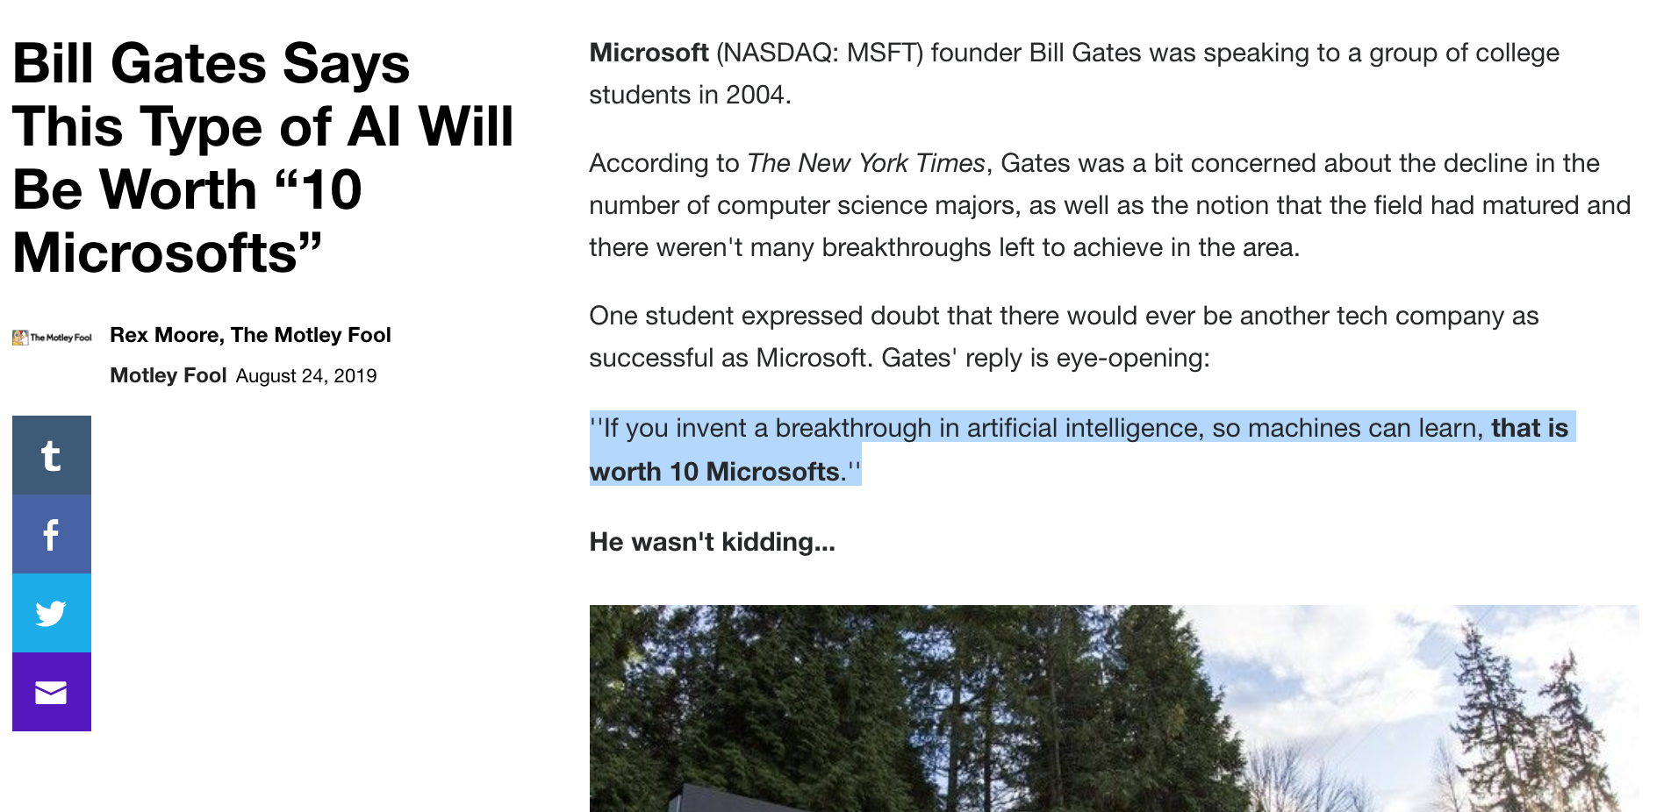

Slide 7
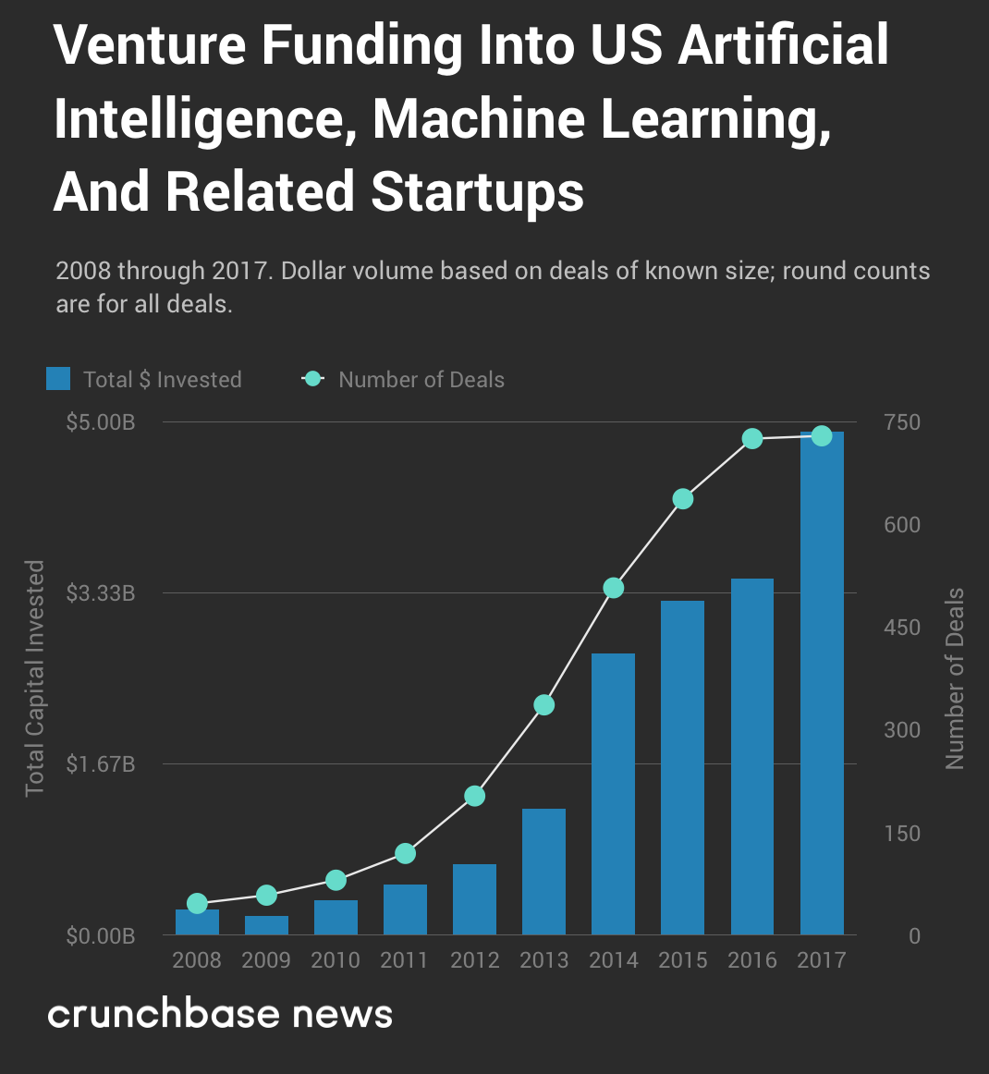

Slide 8
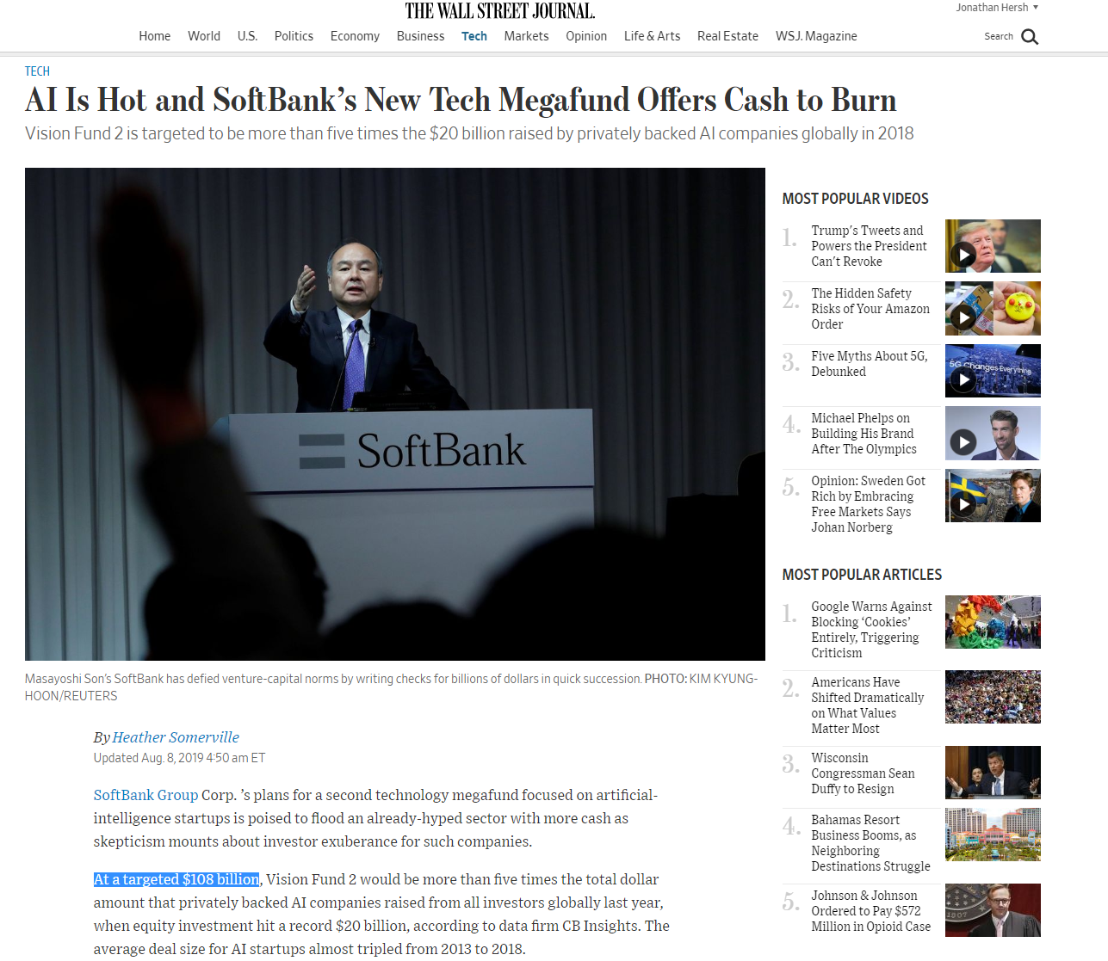

Slide 9
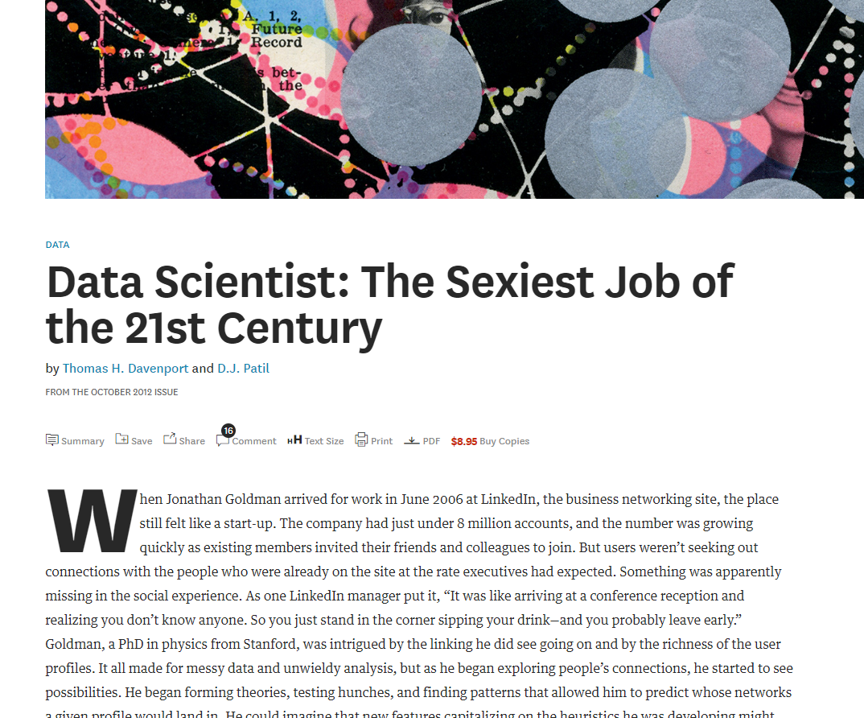

Slide 10
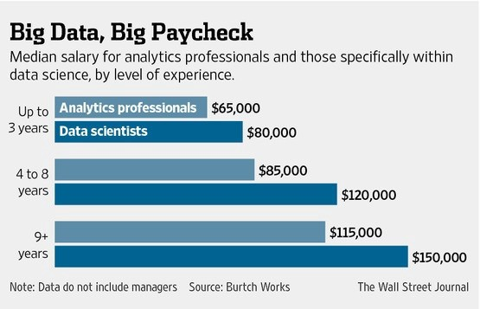

Slide 11
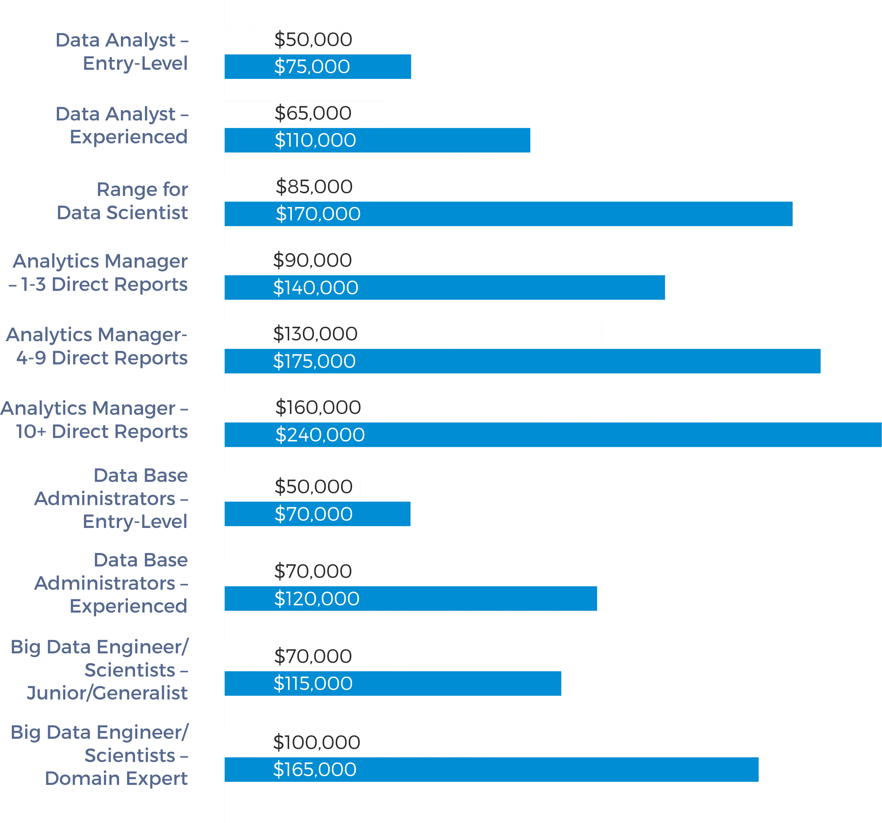
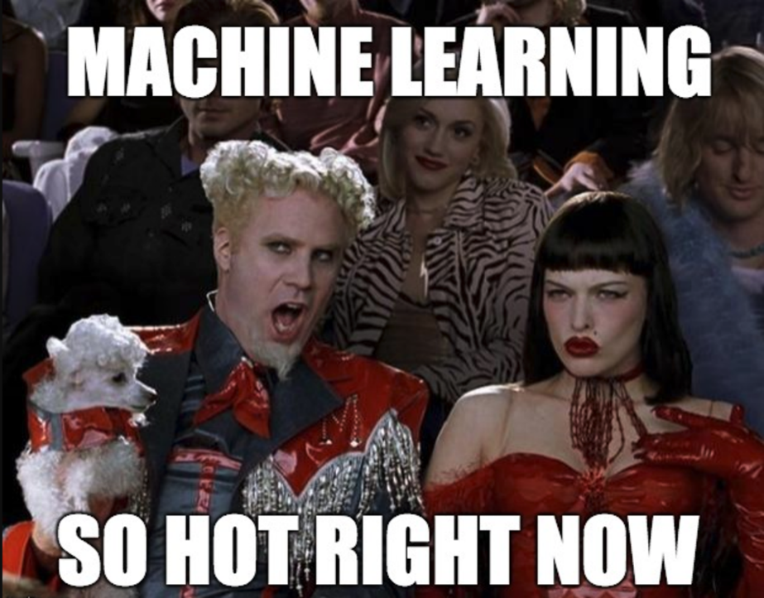

Slide 12
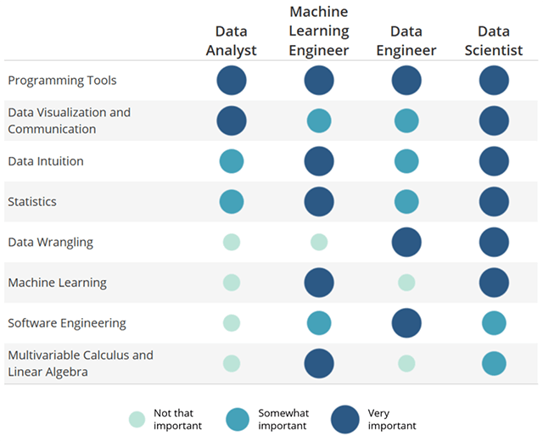
Varied Skills in the Data Science Landscape

Slide 13
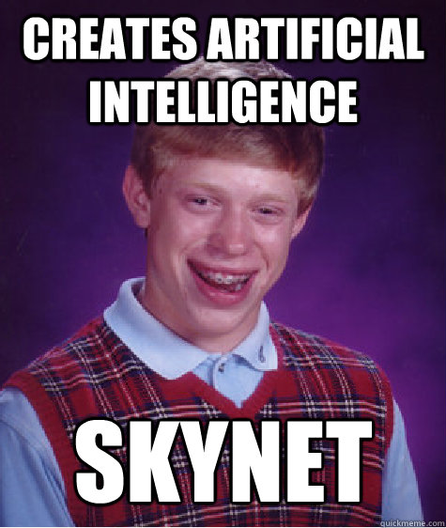



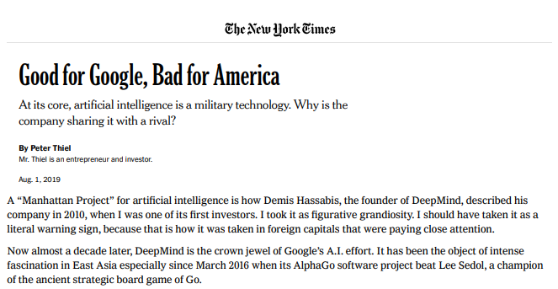
Policy Problems of AI/Big Data

Slide 14
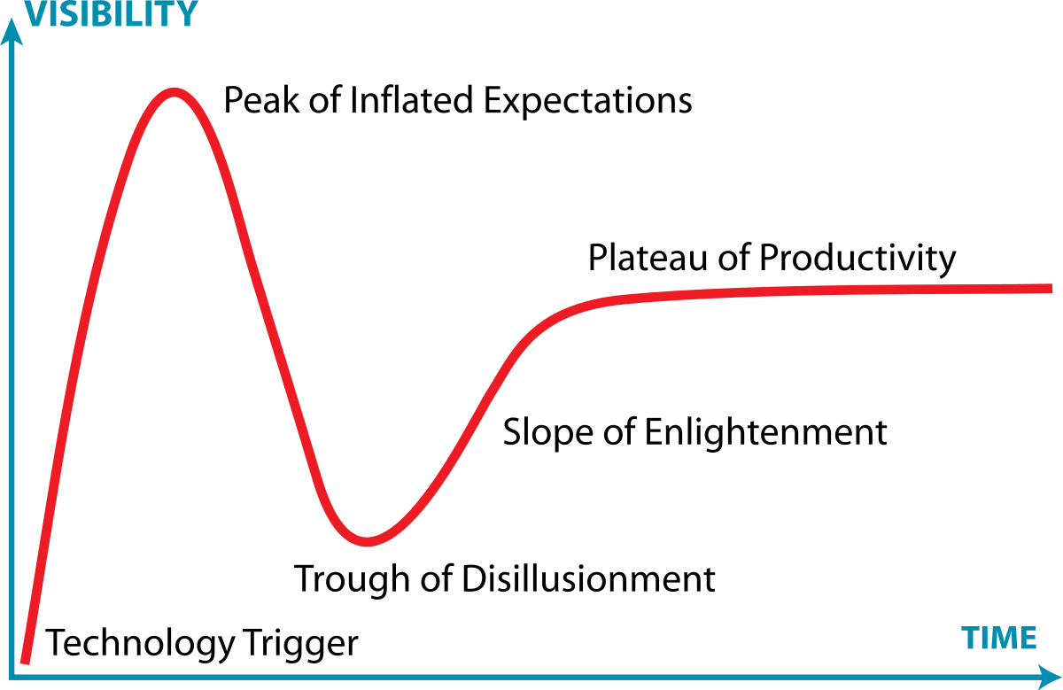
“Hype” Cycle

Slide 15
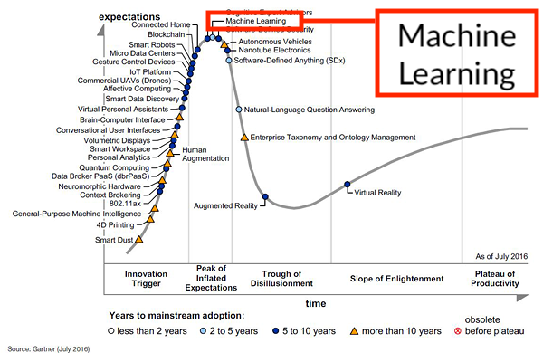
Where are we in the hype cycle?

Slide 16
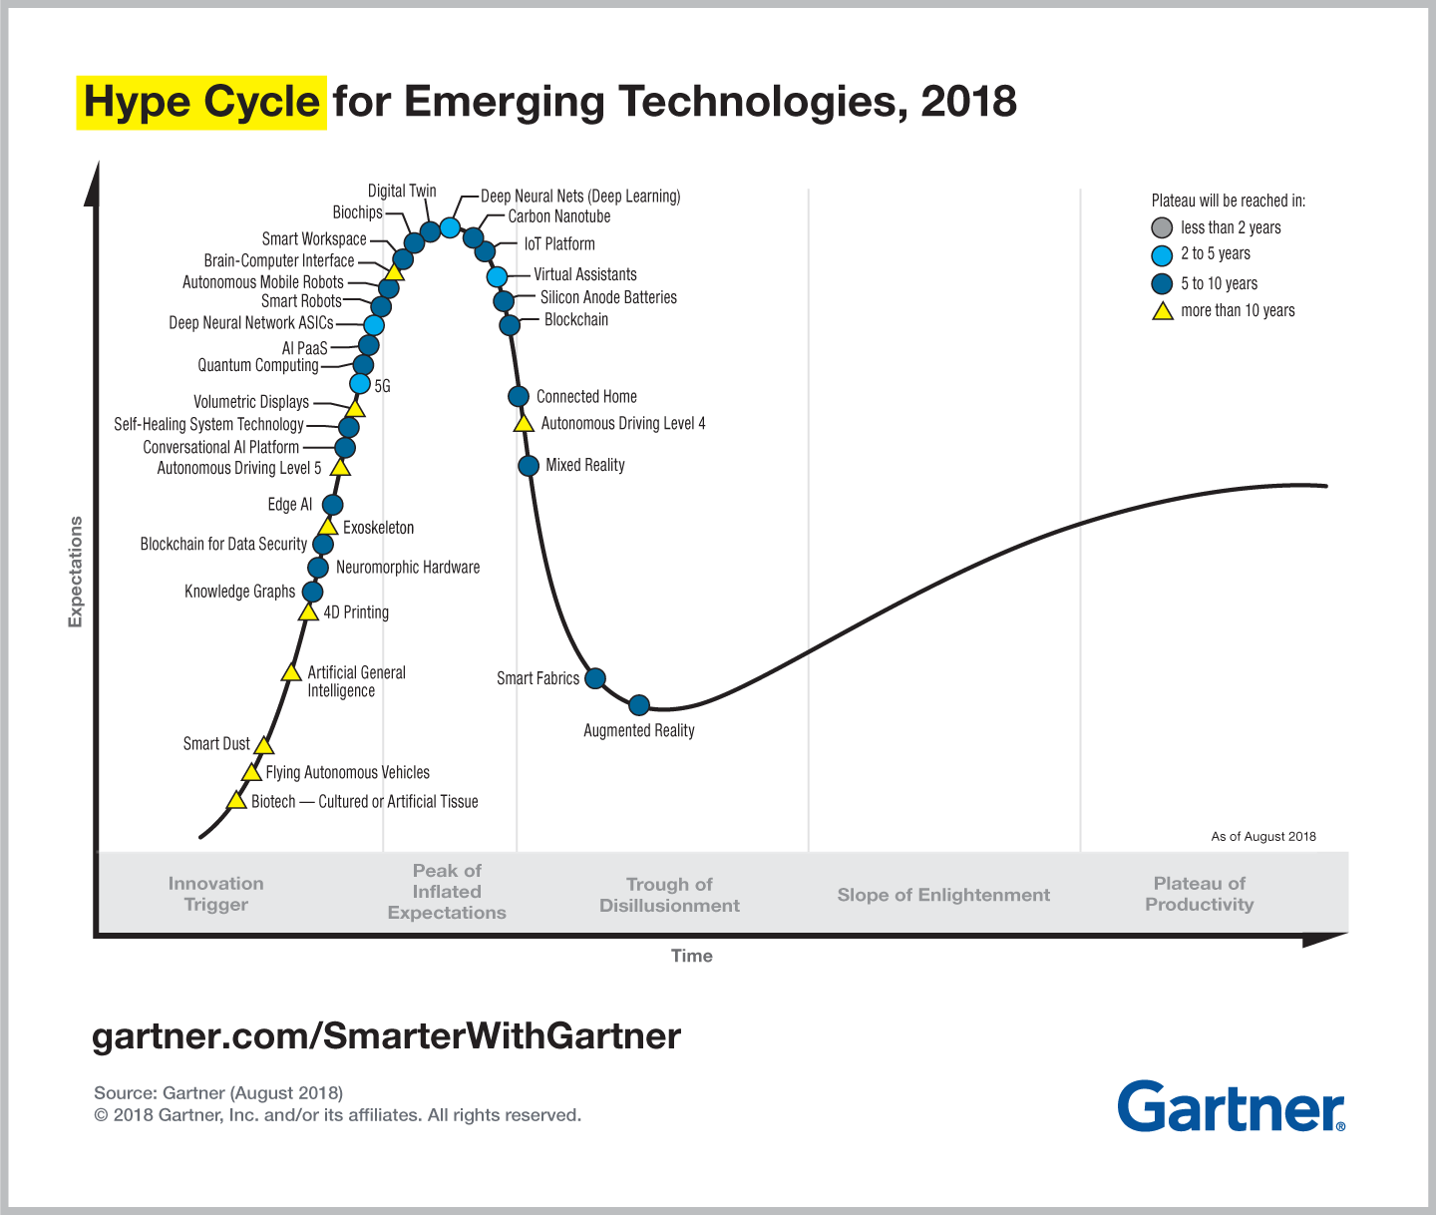
Where are we in the hype cycle?

Slide 17
Ice Breaker
Syllabus
Intro to class materials
Ice Breaker
Section 2: tinyurl.com/IntroMGSC310-Morning
Section 3: tinyurl.com/IntroMGSC310-Afternoon
Intro to R / RStudio

Slide 18
Intro R/R Studio
Download these:
R Studio v.1.2.1335
https://www.rstudio.com/products/rstudio/download/#download
R 3.6.1
Windows: https://cran.r-project.org/bin/windows/base/
Mac: https://cran.r-project.org/bin/macosx/
Or just go here: rstudio.cloud

